Slide 1
CHEMOTHERAPY OF CANCER
R.M., SRSV

Slide 2
CANCER
Cancer- Uncontrolled multiplication and spread within the body of abnormal forms of body's own cells.
Neoplasm– A mass of tissue formed as a result of Abnormal, Excessive, Uncoordinated, Autonomous and purposeless Proliferation of cells.
Complexity- Cancer chemotherapy not as successful as antimicrobial chemotherapy. Metabolism in parasite differs qualitatively from host cells, while metabolism in cancer cells differ only quantitatively from normal host cells – Hence target selectivity is more difficult in cancer – in cancer, there is no substantial immune response – Diagnostic complexity.
Early diagnosis and early treatment: Survival time inversely related to initial number of cancer cells. Aging cancer cells are less susceptible to chemotherapy, because there is – ↑ cell cycle (division) time – ↓No of actively dividing cells with more resting cells – ↑ cell death within tumour – Overcrowding of cells.

Slide 3
CANCER
Chemotherapy sensitivity: Cancer chemotherapy can be curative in Acute Leukemias, Wilm’s Tumour In children, Ewing’s Sarcoma, Choriocarcinoma, Hodgkin’s Disease, Lymphosarcoma, Burkitts lymphoma, Testicular Teratomas, Seminomas.
Chemotherapy can have only Palliative effect in Breast Cancer, Ovarian Cancer, Endometrial Cancer, Prostatic Cancer, Chronic Lymphatic Leukemia, Chronic Myeloid Leukemia, Head & Neck Cancer, Lung (small cell) Cancer.
Chemotherapy is less sensitive in, Colorectal Cancer, Carcinoma of Stomach, Carcinoma of oesophagus, Renal carcinoma, Hepatoma, Bronchogenic (non small cell) carcinoma, Malignant Melanoma, Sarcoma.

Slide 4
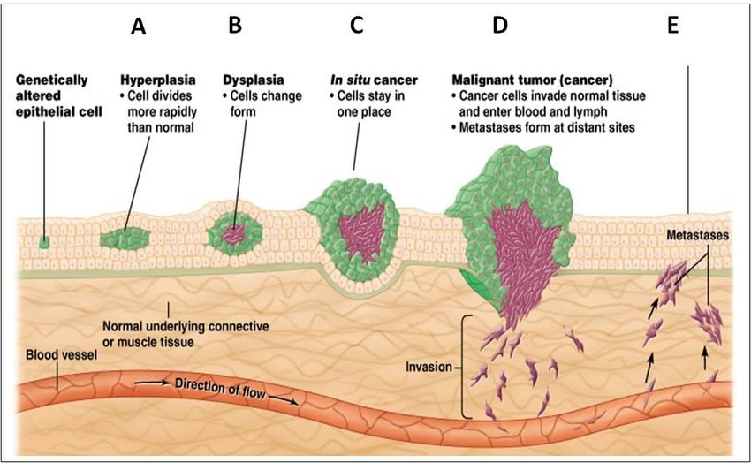
CANCER
Cancer cells differ from normal cells: by Uncontrolled proliferation, De-differentiation & loss of function, Invasiveness and Metastasis.
Pathogenesis of cancer: Development of primary tumour, Production of metalloproteinases, Invasion of nearby tissue by tumour cells, Angiogenesis, Metastasis, Development of secondary tumours.

Slide 5
General Principles in chemotherapy of cancer
Single clonogenic malignant cell is capable of producing progeny that kill the host.
To effective cure, all malignant cells must be killed.
The proliferation rate of cancer cell differs from normal cell. The cytotoxic drugs kill cancer cell by first order kinetics.
‘Combined modality approach’ can be used for cancer therapy.
Poly pharmacy can be used for achieving ‘total tumour cell kill’.

Slide 6
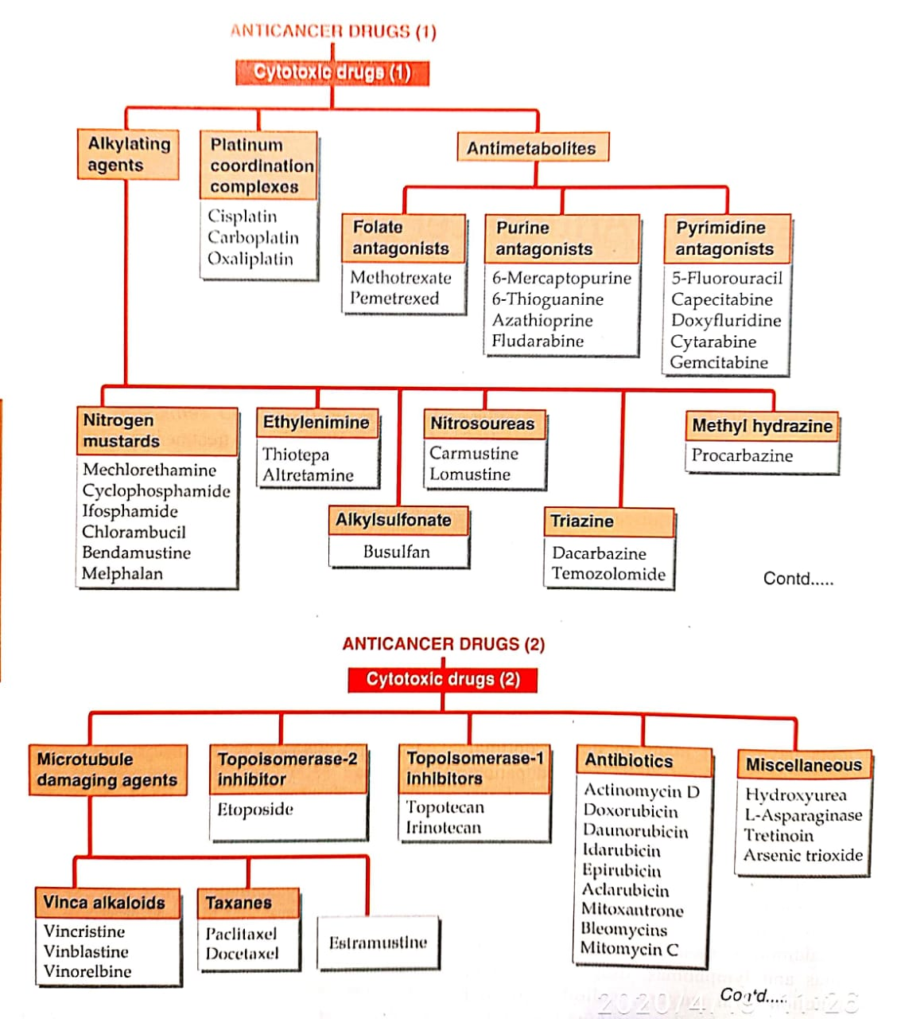
CLASSIFICATION OF ANTI-CANCER DRUGS

Slide 7
Cytotoxic drugs
Cytotoxic drugs are either cell cycle nonspecific (CCNS) or cell cycle specific (CCS).
cell cycle nonspecific (CCNS) drugs, kill resting as well as dividing cells. E.g.: Mustine, cyclophosphamide, chlorambucil, carmustine, cisplatin, L-asparaginase.
cell cycle specific (CCS) drugs, kill only actively dividing cells.
G0 phase: Alkylating agent
G1 phase : Vinblastine
S phase : Methotrexet, cytarabine, fludarabine, 6-MP, 5-FU, hydroxyurea, mitomycin C, doxorubicin, daunorubicin.
G2 phase : Daunorubicin, bleomycin, etoposide, topotecan.
M phase : Vincristine, vinblastine, vinorelbine, paclitaxel, docetaxel

Slide 8
Cytotoxic drugs- Alkylating agents
MOA: -these are compounds that are capable to introduce alkyl group into N site Of DNA , RNA or any enzyme through covalent bond or may cause…. a) Miscoding, b) Destruction of guanine, c) Disruption of nucleic acid function.
The effect of base alkylation include misreading of DNA codon & single strand breakage of DNA chain, mutation & cell death.
Nitrogen mustards & ethyleneimines act by above mech.
Busulfan act by ‘sulfur stripping’.
Nitrosoureas act through liberation of alkylation moiety.

Slide 9
Cytotoxic drugs- Alkylating agents
A) Nitrogen mustards: cyclophosphamide, chlorambucil, mechlorethamine HCl, uracil mustard, Ifosfamide.
This are cytotoxic chemotherapeutic agent similar to mustard gas.
a) Cyclophosphamide: - Inactive invitro but when it administered, it is metabolized by liver into phosphoramide & acrolein. (active comp.) – Phosphoramide: cytotoxic to cancer cell, Acrolein: toxic to bladder - Not properly absorb by oral route, so better to be given by I.V.
USE: Lymphosarcoma, breast, ovarian, lung cancer.
Adverse Effect: N/V/D, BMD, darkening of skin/nails, pulmonary fibrosis, UTI - Dose – 2-3 mg/kg/day oral, 10-15 mg/kg i.v. every 7- 10 days.

Slide 10
Cytotoxic drugs- Alkylating agents
b) Mechlorethamine HCl: - Taken by I.V. infusion.
Use: to treat prostate cancer.
Adverse Effect: allergic reaction, thrombophlebitis, herpes zoster infection, mutagenic & carcinogenic effect on bone marrow stem cell.
Dose: 0.1 mg/kg iv daily x 4 days ; courses may be repeated at suitable intervals
c) Chlorambucil: – Slow acting alkylating agent.
Use: esp. active against lymphoid tissues, myeloid tissues – largely spared (Ch. Lymphatic leukaemia and non- Hodgkin's lymphoma).
Dose: – orally 0.1-0.2 mg/kg daily for 3-6 weeks, then 2 mg daily for maintenance.
Adverse Effect: muscle problem, numbness of hands/feet, hepatotoxicity.

Slide 11
Cytotoxic drugs- Alkylating agents
B) Nitrosoureas: carmustine, lomustine, semustine, streptozotocin - 2 functional group : Nitroso + Urea - highly lipid soluble, & having ability to cross BBB ( So used in brain tumour, meningeal leukaemia ), given i.v.
Adverse Effect: pulmonary toxicity, nephrotoxicity, CNS effects, Visceral fibrosis and Renal damage.
C) Alkylsulfonates: busulphan(i.v.) - alkyl sulfonate, - highly selective for myeloid elements; Granulocyte precursors(most sensitve) > Platelets and RBC.
USE: to treat chronic myelogenous leukaemia (CML) in bone marrow transplantation patients.
Adverse Effect: Constipation, Seizure, little effect on lymphoid tissue and GIT Hyperuricemia(common)

Slide 12
Cytotoxic drugs- Alkylating agents
D) Ethylenimines: Thio-TEPA (i.v) - High Toxicity - USED – Ovarian and Bladder Cancer
E) Thiazenes: decarbazine (i.v.) - after activation in liver – methylating DNA , - most imp. Indication – malignant melanoma, also – Hodgkin's lymphoma
F) Methylhydrazines: Procarbazine(i.v./orally(gel capsule)) - In vivo they convert into azo der. Or active against tumour cells. - Used : in Hodgkin's disease with combination of MVPP. (M – mechlorethamine V - vincristine P - Procarbazine P – prednisone).
Platinum based alkylating agents: cisplatine, carboplatin, oxaliplatin - They having no alkyl group , but also damage DNA, & trigger apoptosis.

Slide 13
Cytotoxic drugs- Platinum based alkylating agent
platinum is only heavy metal compound used in cancer. a) Cisplatine: - Act against cells which in S- phase, M-phase. Effects resemble, alkylating agent and radiation. Plasma protein bound, penetrates tissues, Slowly excreted in urine, T1/2 – 72 hrs.
Use: ovarian, testicular, endometrial, bladder, Lung and Oesophageal Cancer.
Adverse Effect: Aloplacia, maylosuppression, nephrotoxiciy, Ototoxicity, Electrolyte disturbances- Hypokalemia, Hypocalcemia and Hypomagnesemia, Rarely Anaphylactic shock, Mutagenic , Teratogenic and Carcinogenic properties.
Dose: Cisplatin adm. Slow i.v infusion 50-100 mg/m2 BSA every 3-4 weeks.

Slide 14
Cytotoxic drugs- Antimetabolites
Antimetabolites are structurally related to normal compounds that present with in cell. They generally interfere with… a) availability of purine or pyrimidine nucleotide precursors. b) Either by inhibiting their synthesis c) or by competing with them in DNA or RNA synthesis. Their max. cytotoxic effect are in S –phase ( therefore, cell cycle specific ).
A) Folic acid antagonist: methotrexate (Mtx):
MOA: Folic acid is an essential dietary factor. It is converted by enzymatic reduction to a series of tetrahydrofolate cofactors that provide carbon groups for synthesis of precursors of DNA & RNA. Mtx inhibits the enzyme DHFR. Which leads to depletion of tetrahydrofolate cofactor used for DNA & RNA synthesis. Also used to inhibit thymidylate synthase (TS).

Slide 15
Cytotoxic drugs- Antimetabolites
Dose: Choriocarcinoma; 15-30 mg/day for 5 days orally or 20-40 mg/m2 BSA i.m. or i.v. twice weekly. Low dose Mtx (7.5-30 mg once weekly) – Rheumatoid Arthritis, psoriasis.
RESISTANCE: - Due to reduction of affinity of DHFR to MTX, Diminished entry of MTX into cancer cells, Over production of DHFR enzyme.
USES: Combine with other drug in - Lymphocytic leukaemia, breast cancer, head & neck carcinoma. In low dose effective against some inflammatory disease, like…. - severe psoriasis, rheumatoid arthritis, crohn disease, etc. - Other Uses – Psoriasis and in Organ transplantation.
Kinetics: Routes of Adm.: oral, I.M., I.V., I.T. - 50% bound to plasma proteins, Poorly crosses BBB.

Slide 16
Cytotoxic drugs- Antimetabolites
Metabolism: Mtx bio-transformed into polyglutamate derivative, or at high dose undergo hydroxylation at 7 position & form 7- hydroxy Mtx. - Less water soluble, so produce crystalluria.
Excreted by urine.
Adverse Effect: Stomatitis, rash, urticaria, alopecia, myelosuppression, - Most frequent toxicities:
Hepatic function: long term use of Mtx may lead to cirrhosis.
Neurological toxicities: meningeal irritation, stiff neck, fever, headache, rarely seizures.
Precaution: - because Mtx is teratogenic, it should be avoided in pregnancy.

Slide 17
Cytotoxic drugs- Antimetabolites
B) Purine analogues: 6-MP, 6-TG, azathioprine, fludarabine.
Use: Highly effective agent, Purine antagonist used for treatment of malignant tumer (6-MP, 6-TG)but also prove beneficial for treating neoplastic disease ( immunosuppresion (azathioprine) and in antiviral chemotherapy (acyclovir, ganciclovir, vidarabine, zidovudine)).
6-MP: MOA: 6-MP inhibit the conversion of inosine monophosphate to adenine & guanine nucleotide formation, which are responsible for RNA & DNA formation. This results in non-functional RNA & DNA formation.

Slide 18
Cytotoxic drugs- Antimetabolites
Kinetics: - Oral administration, well distributed except for the CSF.
Metabolized in the liver, 6-MP is converted into 6- ethyl MP derivative Or to thiouric acid.
The parent drug & its metabolites are excreted by kidney.
Adverse Effect: -Anorexia, hepatotoxicity in the form of jaundice has been reported in about one third of adult patients.
Dose: 2.5 mg/kg/day, half dose for maintenance.

Slide 19
Cytotoxic drugs- Antimetabolites
6- TG: 6-TG is also purine analogue, is primarily used in treatment of acute non-lymphocytic leukemia in combination with Daunorubicin & cytarabine.
MOA: Converted 6-TG/6-MP to TGMP by enzyme hypoxanthineguanine phosphoribosyltransferase (HGPRT). TGMP further converted into di & tri phosphate, Which inhibit biosynthesis of GMP to guanosine diphosphate
Kinetics: similar to 6- MP
Adverse Effect: TG is not recommended for maintenance therapy or continuous long term treatment due to the risk of liver toxicity.
Dose: 100-200 mg/m2 /day for 5-20 days.

Slide 20
Cytotoxic drugs- Antimetabolites
C) Pyrimidine analogues: 5- FU, cytarabine, azarabine, floxuridine.
MOA: 5-FU converted into 5-fluro-2-deoxyuredinemonophosphate (5-FduMP) which inhibit thymidylate synthase and blocks the conversion of deoxyuridilic acid to deoxythymidylic acid. • 5-FU incorporated into RNA, interferes with RNA synthesis and causing cytotoxic effect. This drug produce anticancer effect in the S – phase of the cell cycle.
Kinetics: • Oral absorption of 5-FU is unreliable & Because of its severe toxicity to the GI tract, primarily used by i.v. infusion or, in the case of skin cancer , given topically.

Slide 21
Cytotoxic drugs- Antimetabolites
Metabolism: 5-FU rapidly metabolized by dihydropyrimidine dehydrogenase (DPD) resulting in a plasma T1/2 15- 20 mins after i.v. infusion. Genetic deficiency of DPD causes severe 5-FU toxicity.
Adverse Effect: Alopecia, severe ulceration in the oral & GI mucosa, myelosuppression, mucositis, peripheral neuropathy, BMD & anorexia are frequently encountered. • 5-FU also cause “ HAND- FOOT SYNDROME “is seen after extended infusions.
USE: • primarily in the treatment of slow growing solid tumours (colorectal, breast, ovarian, pancreatic, & gastric carcinoma)
Dose: – 25 mg/m2 BSA daily for 5 days every 28 days by i.v. infusion.

Slide 22
Cytotoxic drugs-Microtubule damaging Agents
A) Vinca Alkaloids: Vincristine & vinblastine
MOA: (mitotic spindle inhibitor) - these agent bine specifically to protein tubulin & inhibit polymerization of microtubules. This prevent formation of spindles & blockade of mitotic division at metaphase. They act primarily on the M phase of cancer cell cycle.
Kinetics: Given parenterally, penetrate most tissues except CSF cleared mainly via biliary secretions.
Adverse Effect: leukopenia, mental depression, loss of sleep, headache, anorexia, constipation, alopecia, peripheral neuritis.
Uses: Lympho-sarcoma , Hodgkin's disease , lymphatic leukaemia , cancer of breast, testes, kidney B)

Slide 23
Cytotoxic drugs-Microtubule damaging Agents
B) TAXANES: paclitaxel, docetaxel
MOA: - same as Vinca alkaloid, taxanes act on microtubules & stabilize them.
Adverse Effect: - bone marrow depression, alopecia, muscle pain, neurotoxicity - allergy to paclitaxel is also common and many a time corticosteroids & antihistamines are to be used to control allergy.
USES: ovarian & breast cancer

Slide 24
Cytotoxic drugs- Epipodophylotoxin
Etoposide, teniposide
MOA: - They act by inhibition of mitochondrial function & nucleotide transport. - They also bind to topoisomerase II & DNA, causing breaking of DNA. - This drug are most active in late s-phase & early G2- phase.
Kinetics: Orally well absorbed and distributes to most body tissues , Elimination is mainly via kidneys.
Adverse Effect: myelosuppression, alopecia
Use: testicular tumour, lung carcinoma along with cisplatin, non- Hodgkin's lymphoma & lymphoblastic leukaemia in children

Slide 25
Cytotoxic drugs- Campothecins
Irinotecan , topotecan - Camptothecin analogues
MOA: - they block Topoisomerase-І, which occur in high levels throughout the cell cycle. No resealing of DNA after strand has untwisted.
Topotecan: – Used in metastatic ovarian cancer – Major toxicity is bone marrow depression.
Irinotecan: – Used in metastatic cancer of colon/rectum.
Toxicity: diarrhoea, neutropenia, thrombocytopenia, cholinergic side effects.

Slide 26
Cytotoxic drugs- Antibiotics
Actinomycin- D, Daunorubicin, Doxorubicin, Mitomycin, Bleomycin.
1) Actinomycin- D or Dactinomycin:
MOA: It is an anticancer antibiotic which bind with DNA & form complex with it. Also inhibits topoisomerase II & produce cytotoxicity. Also interrupts function of DNA.
A.E. : (Dactinomycin) anorexia, BMD.
USE: in lymphoma, Hodgkin's disease
2) Daunorubicin or Doxorubicin:
MOA: - it is bind with DNA & intercalate with adjacent pairs & disrrupts DNA activity , also inhibite DNA gyrase & produce cytotoxicity.

Slide 27
Cytotoxic drugs- Antibiotics
PK: - Doxo and Daunorubicin must be given IV. - Metabolized in liver , excreted in bile and urine.
A.E. : - This agents are highly toxic to myocardium & produce arrhythmia, also produce BMD , HT.
Use: - Doxorubicin – Hodgkin's and non-Hodgkin’s lymphoma, myelomas, sarcomas, breast, lung, ovarian and thyroid cancer - Daunorubicin – acute leukemias.
3) Bleomycin:
MOA: acts in the G2 phase- generates free radicals – bind to DNA – DNA strand breaks – inhibit DNA synthesis.
PK : Given parenterally, inactivated by tissue amino peptidases mainly

Slide 28
Cytotoxic drugs-Antibiotics
A.E. : cause minimal BMD but produce serious effect i.e. pulmonary fibrosis. rarely produce nausea, vomiting, headache, hypotension • cutaneous toxicity (hyperpigmentation ,hyperkeratosis, erythema and ulcers)
bleomycin should be given prior to radiation therapy because it’s most sensitive to radiation.
USES: used in carcinoma of skin, upper respiratory passages, oral cavity, urinogenital tract.

Slide 29
Cytotoxic drugs- Enzymes
L-Asparaginase: Isolated from E.coli, Enzyme used for treatment of leukaemia's and lymphomas. These tumours require exogenous asparagine for growth, L- Asparaginase acts by depleting this amino acid in serum.
Use: Acute Lymphocytic Leukemia
Dose: 6000 to 10000U/kg IV daily for 3-4 weeks
AE : Hepatic damage, hypersensitivity, haemorrhage, hyperglycaemia, headache, hallucinations , confusion, coma in thrombosis.

Slide 30
THANKS

